Slide 1

HOW TO USE THIS TEMPLATE
?
Follow the instructions on each slide to create your presentation.
Remember a PowerPoint is a visual for your presentation. The words on each slide should serve only as talking points (rather than everything you are going to say).
Images and graphics add interest; be sure to add them to your slides when appropriate.
Choose Transitions and Animations carefully. (You want your audience to focus on your content, rather than your effects.)

Slide 2
Hako-1.0
Massive Voxel Renderer
Ushiostarfish

Slide 3
Concept
Massive number of voxels
No Triangles, only voxels
A stupidly simple GPU (HIP/CUDA) renderer
Only diffuse material
No even MIS
Only IBL importance sampling

Slide 4
Workflow
Input Scene ( Triangles )
Voxelize
Voxels ( Morton code + Color )
Radix sort
ALL tasks are done on the GPU
Bottom-up octree build
Octree
Render

Slide 5
Spec
1440 x 900
24 fps ( 240 frames )
128 sample per pixel
Voxel Resolution 256 to 7000

Slide 6
The scene – moose making

Slide 7
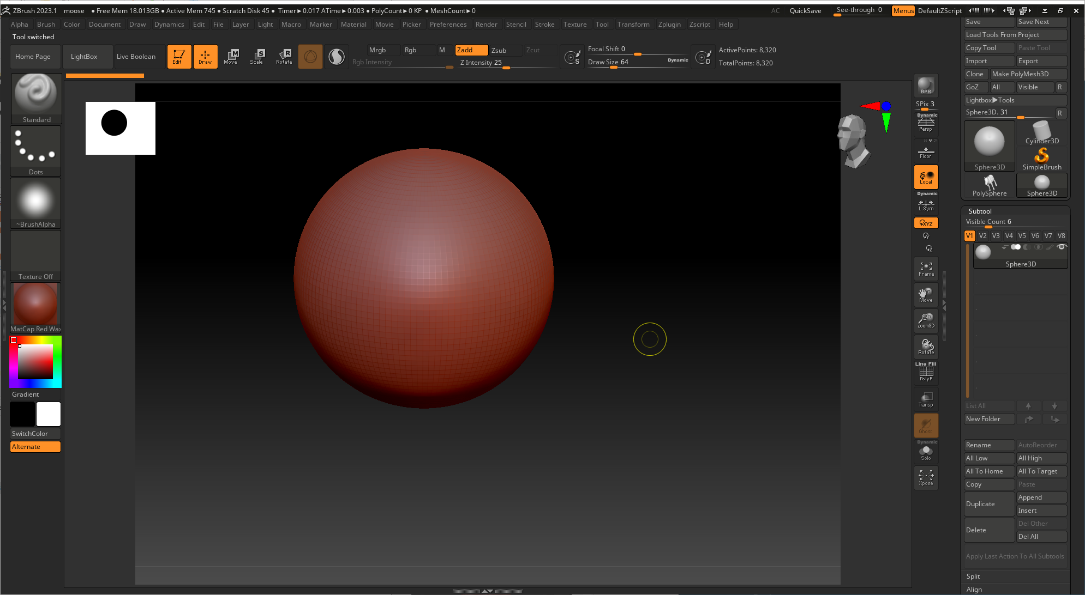

Slide 8
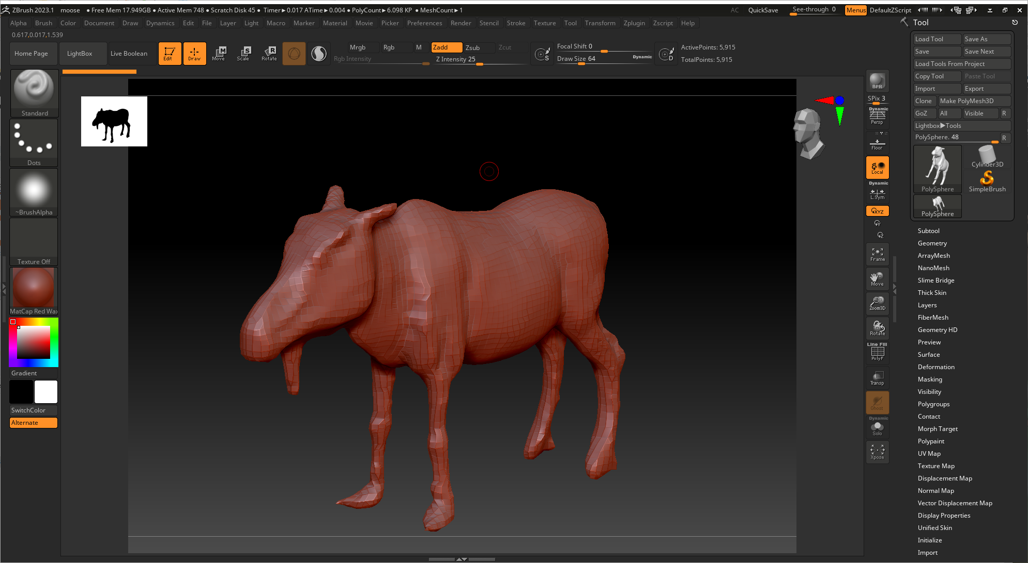

Slide 9
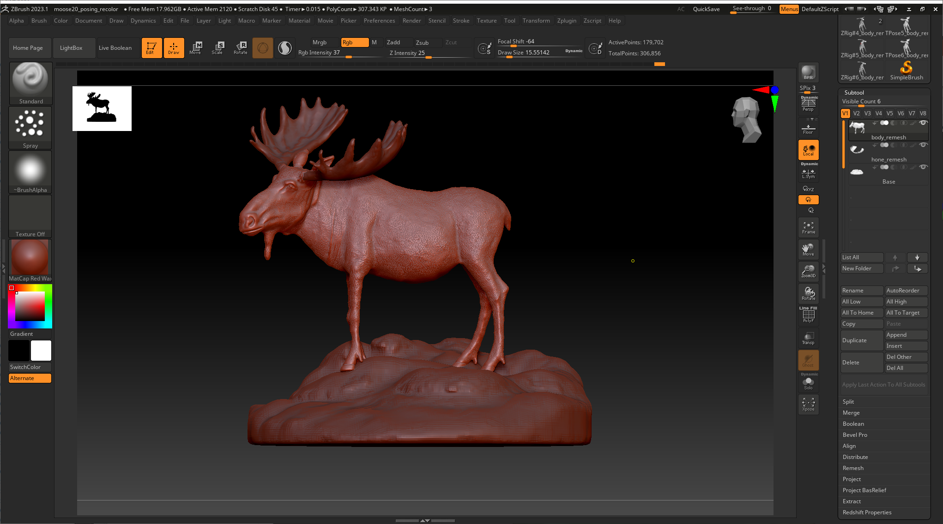

Slide 10
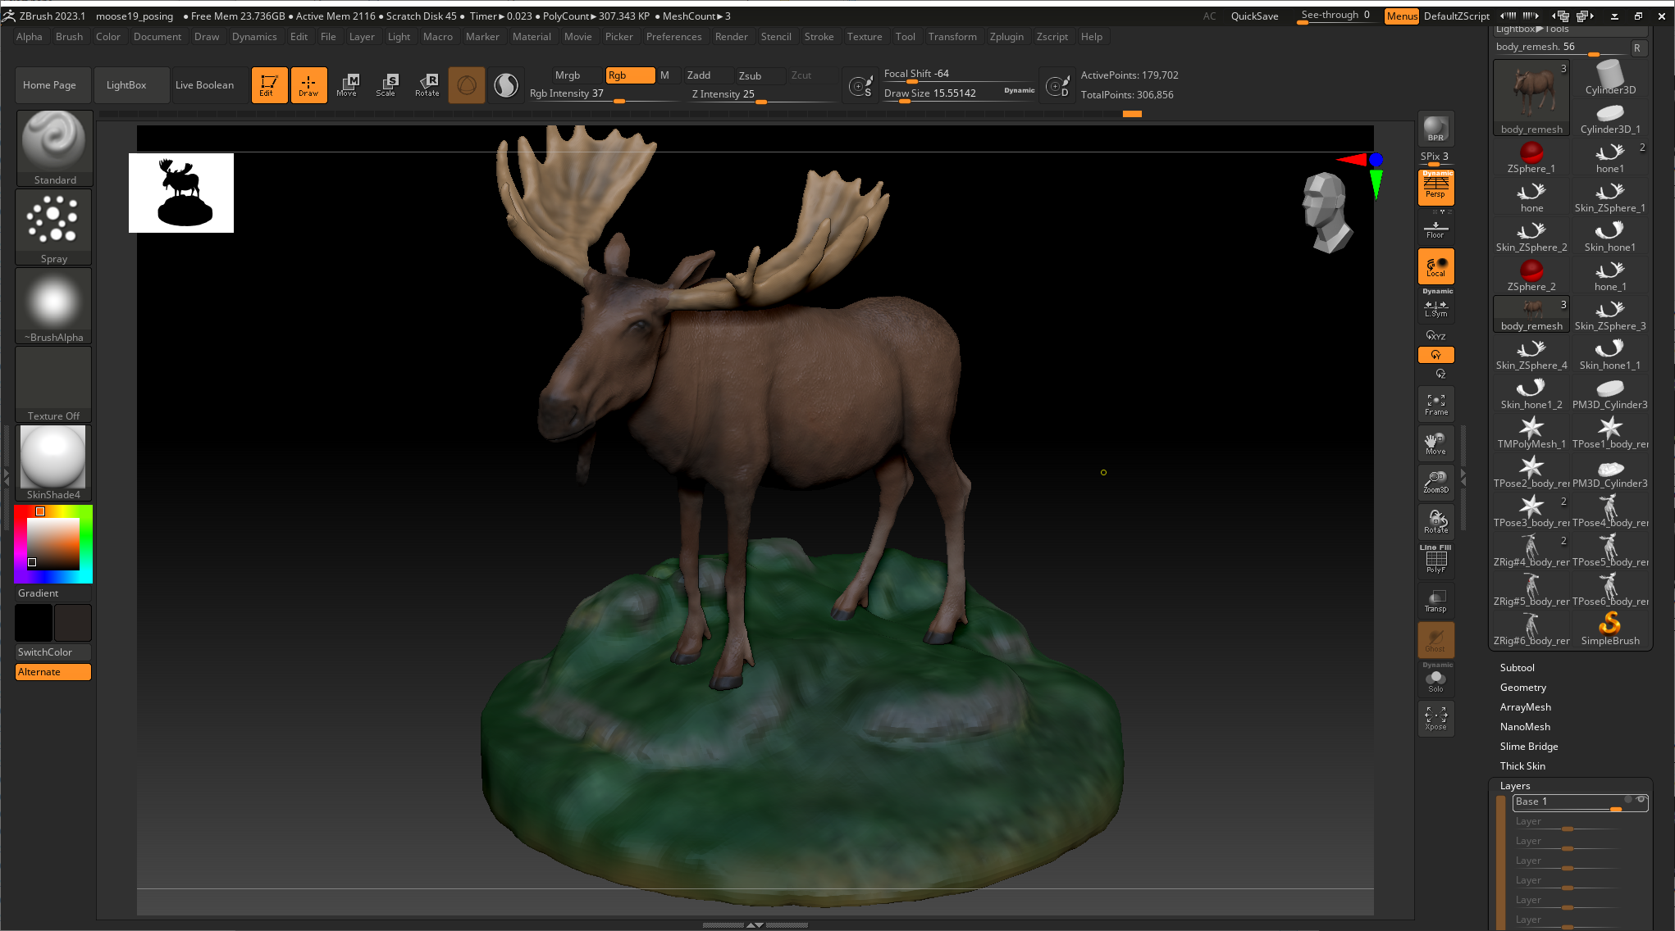

Slide 11
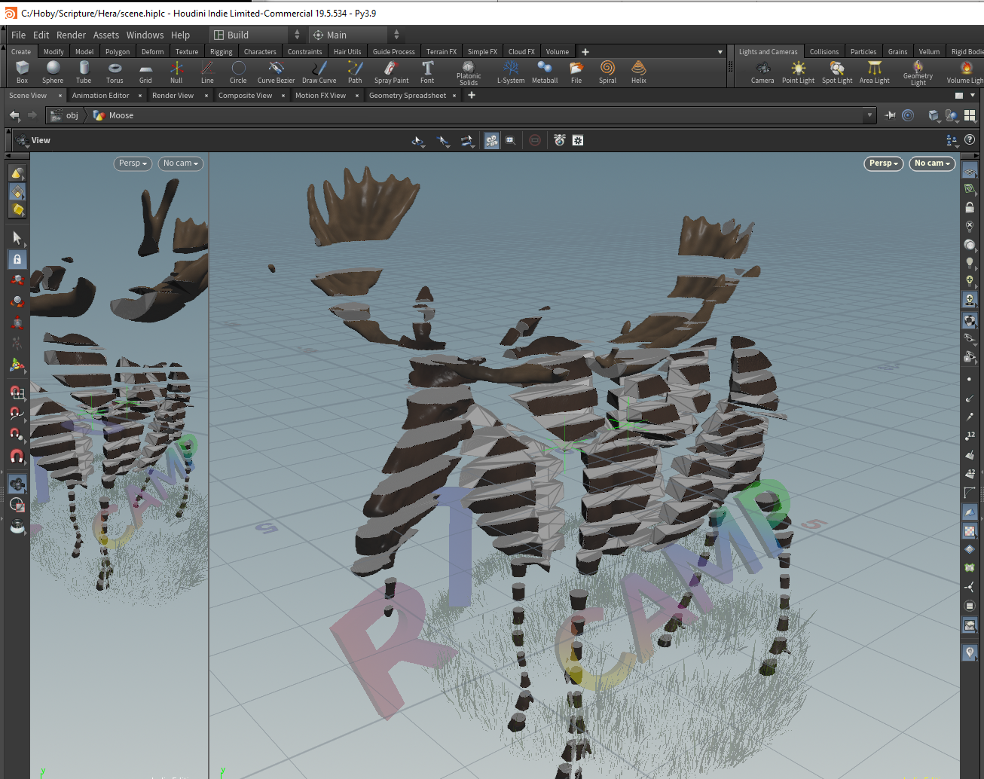
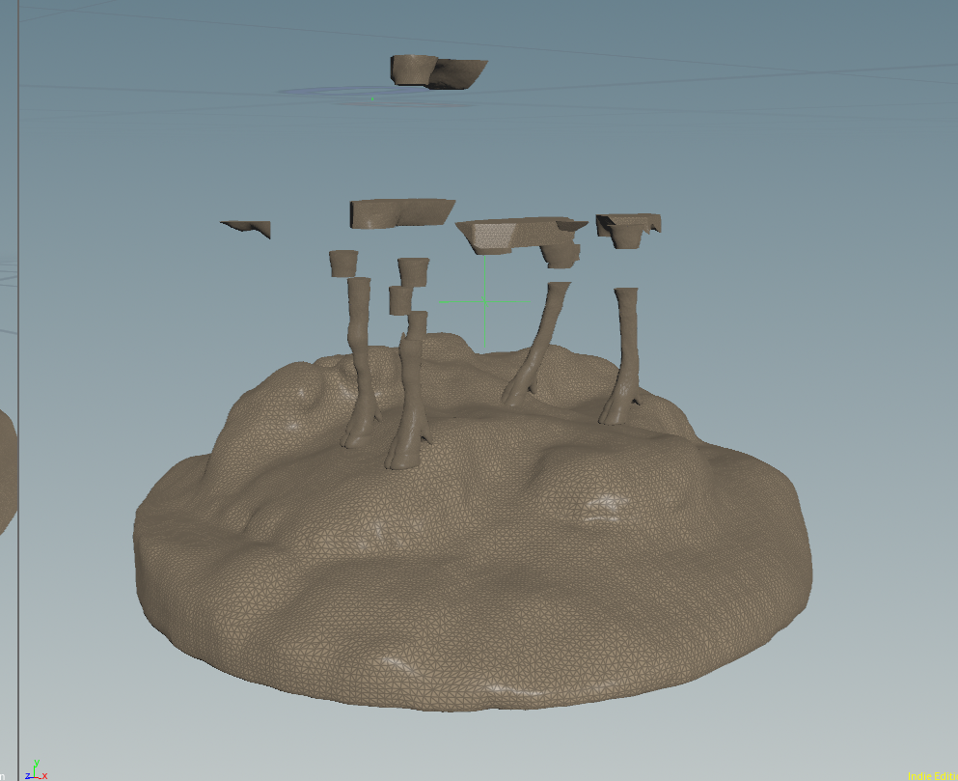
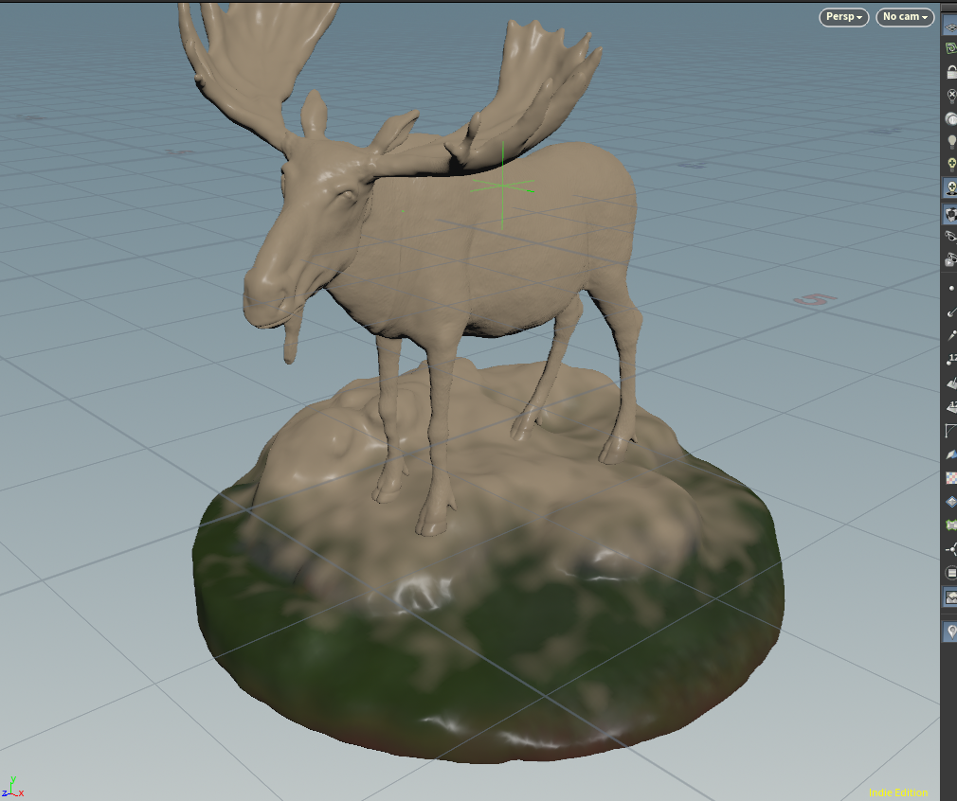
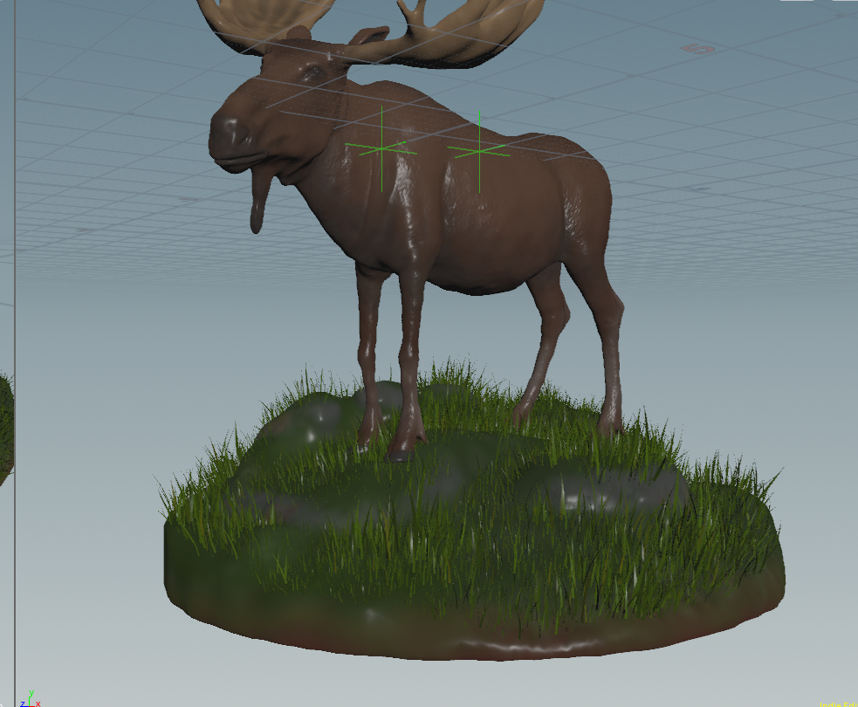
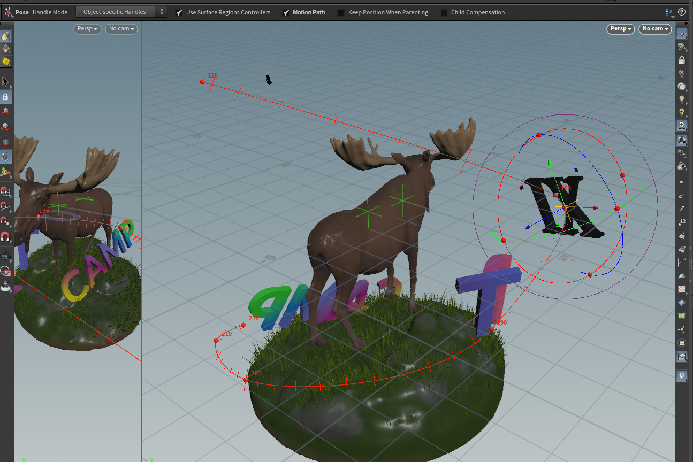
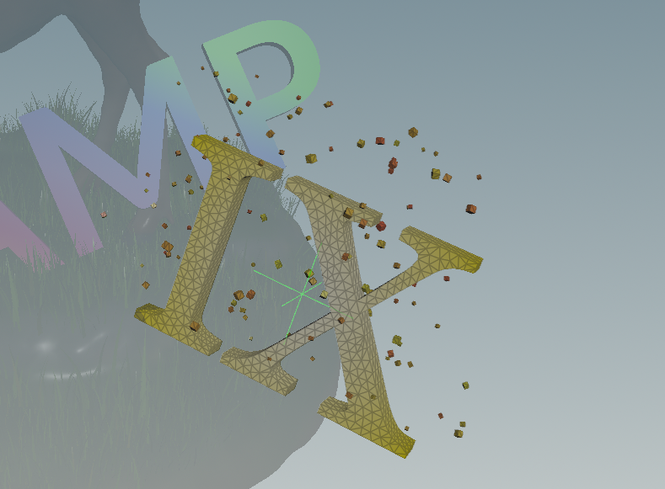

Slide 12
More Voxels?

Slide 13
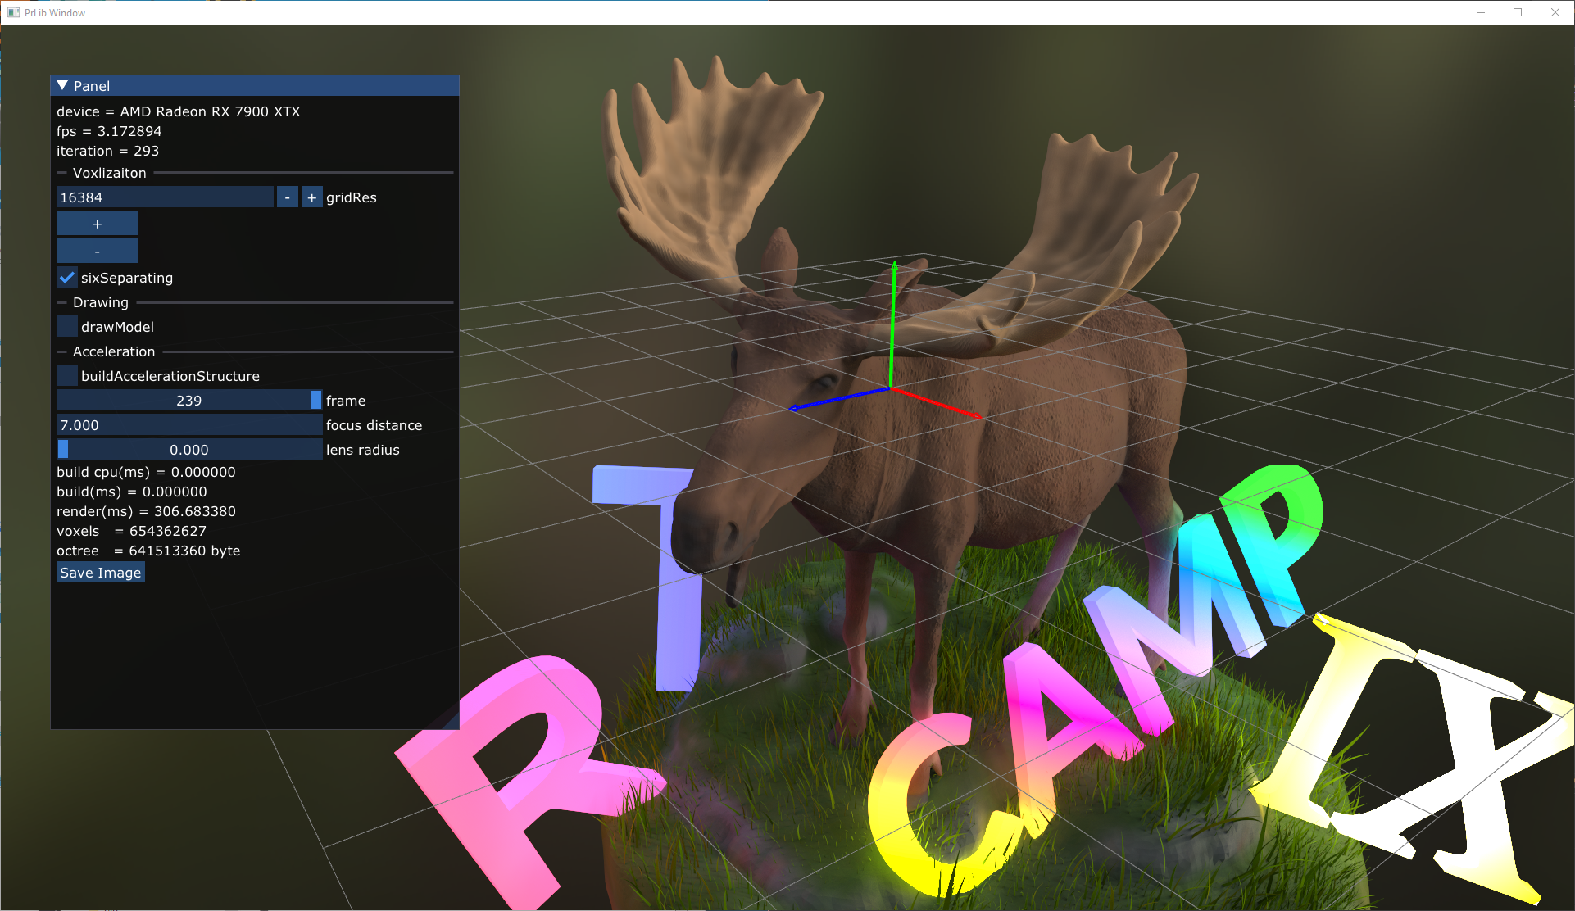
24 gb gpu
16k x 16k x 16k voxels grid
654 M voxels
641 M bytes for Octree

Slide 14
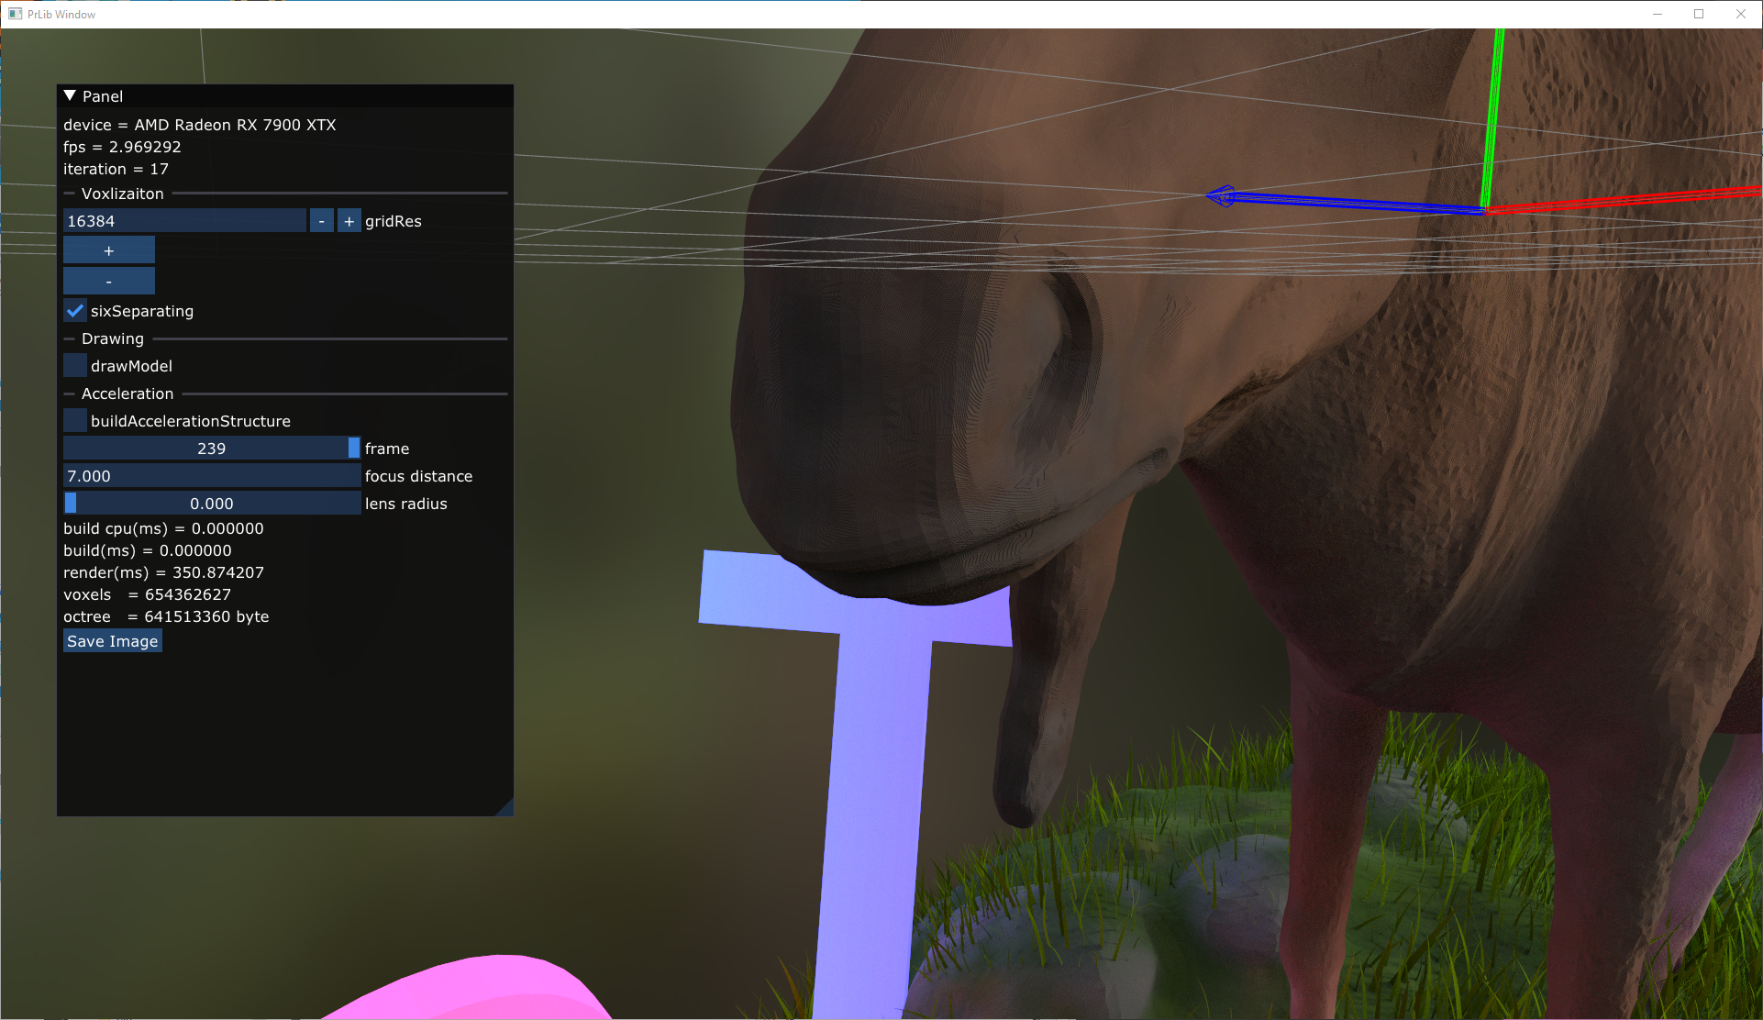
16k x 16k x 16k voxels grid
654 M voxels
641 M bytes for Octree

Slide 15
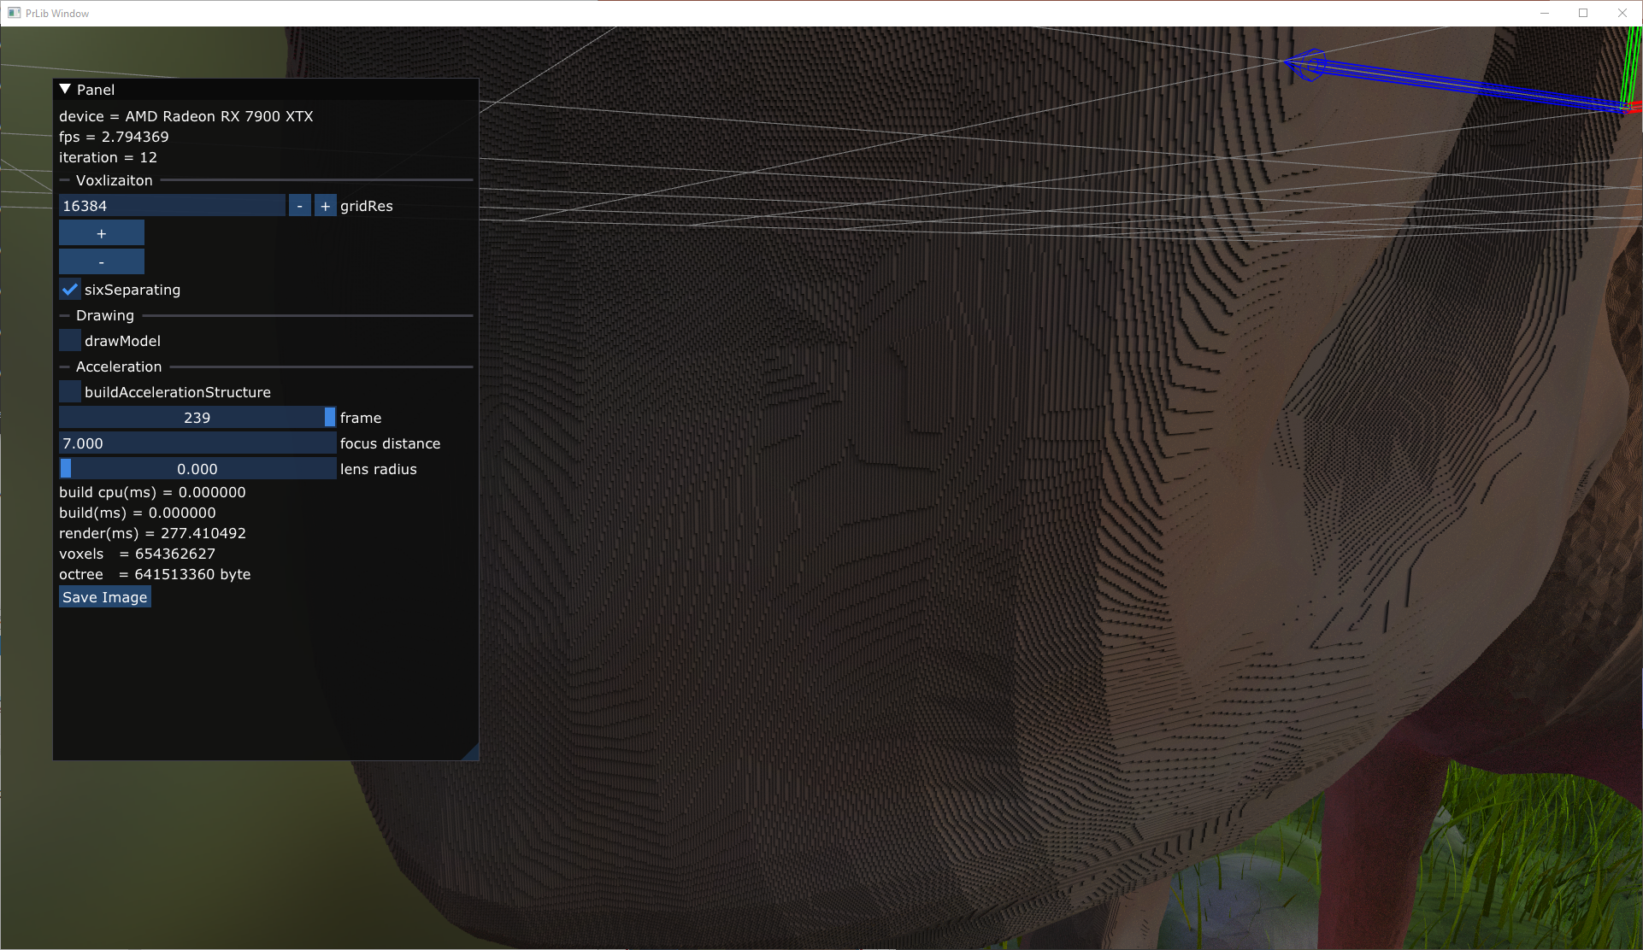
16k x 16k x 16k voxels grid
654 M voxels
641 M bytes for Octree

Slide 16
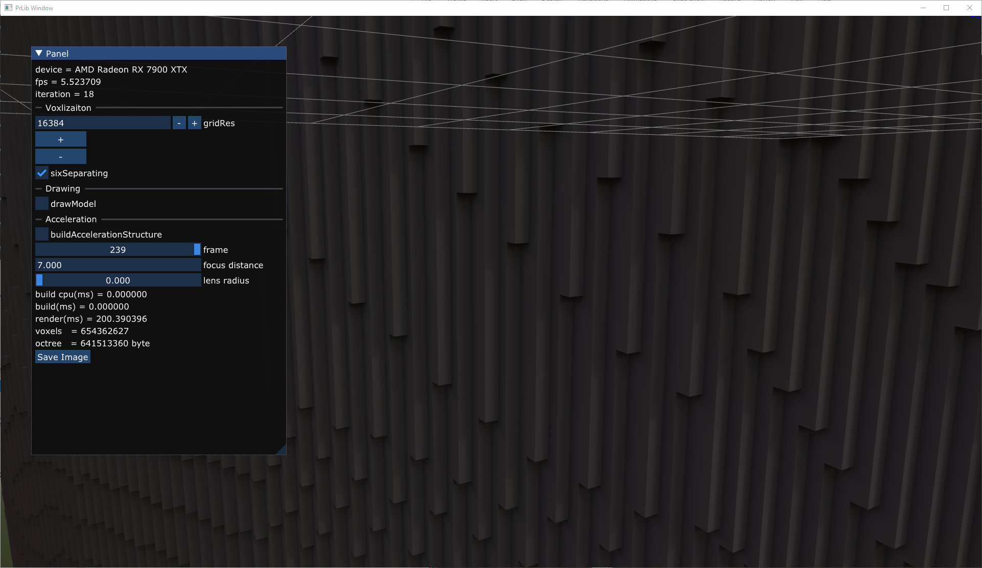
16k x 16k x 16k voxels grid
654 M voxels
641 M bytes for Octree

